Slide 1
Lecture 8
Web Programming
DOM - Document Object Model
Notes:
html

Slide 2
Document Object Model - DOM
A programming interface for web documents
Represents the HTML structure as a tree
Enables JavaScript to interact with web pages dynamically

Slide 3
DOM Structure
The DOM is structured like a tree
Root Node → Document
Element Nodes → HTML elements
Attribute Nodes → Attributes inside elements
Text Nodes → Text inside elements

Slide 4
How DOM Works
Browser parses an HTML document and creates a DOM tree
JavaScript can modify this tree dynamically
The DOM is an in-memory representation of the document

Slide 5
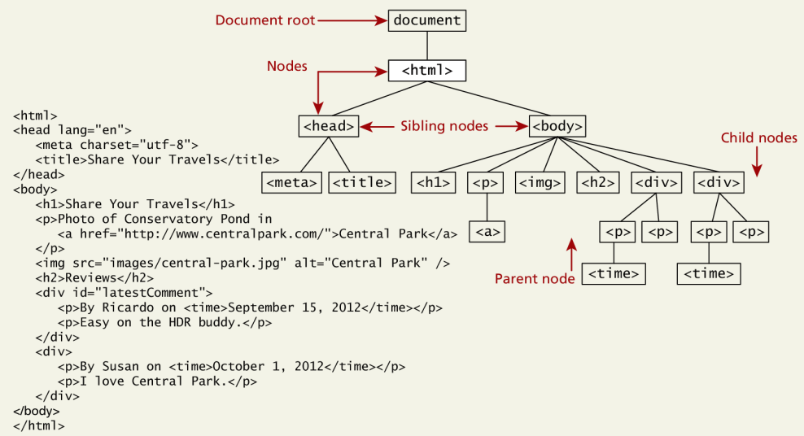
DOM Tree

Slide 6
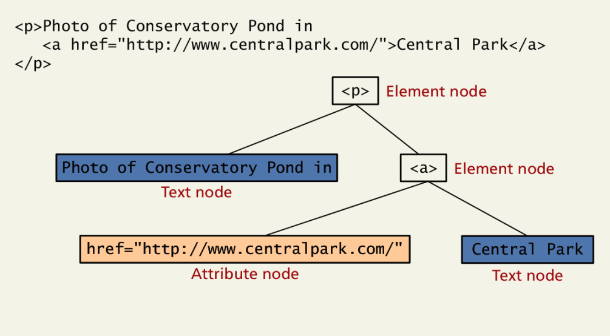
DOM Node

Slide 7
Accessing DOM Elements
document.getElementById('id')
document.getElementsByClassName('class')
document.querySelector('selector')
document.querySelectorAll('selector')
document.getElementsByTagName("tagName")

Slide 8
Modifying the DOM
Change content: element.innerHTML = ‘<div> new element</div>’
Change text: element.textContent = "New Text";
Change styles: element.style.color = 'blue';
Add elements: document.createElement('tag');
Remove elements: element.remove();

Slide 9
Event Propagation
Event propagation refers to the way events travel through the DOM tree.
There are three phases of event propagation:
Capturing Phase (Event Capturing) → 🔽 Going from the root (document) down to the target element.
Target Phase (At Target) → 🎯 The event reaches the actual target element.
Bubbling Phase (Event Bubbling) → 🔼 The event bubbles up from the target back to the root. (default)

Slide 10
Event Propagation
Capturing Phase:
Event starts from the document (or window) and propagates down the DOM tree.
During this phase, the event is captured by all parent elements before reaching the target.
Target Phase:
The event reaches the target element where the event handler is triggered.
Bubbling Phase:
After reaching the target, the event bubbles back up from the target element to the root.
Handlers on ancestor elements can respond in this phase.

Slide 11
Getting the first and last element
First Element
// Get all <p> elements
let paragraphs = document.getElementsByTagName("p");
// Select the first one
let firstParagraph = paragraphs[0];
Last Element
// Get all <p> elements
let paragraphs = document.getElementsByTagName("p");
// Select the last one
let lastParagraph = paragraphs[paragraphs.length - 1];

Slide 12
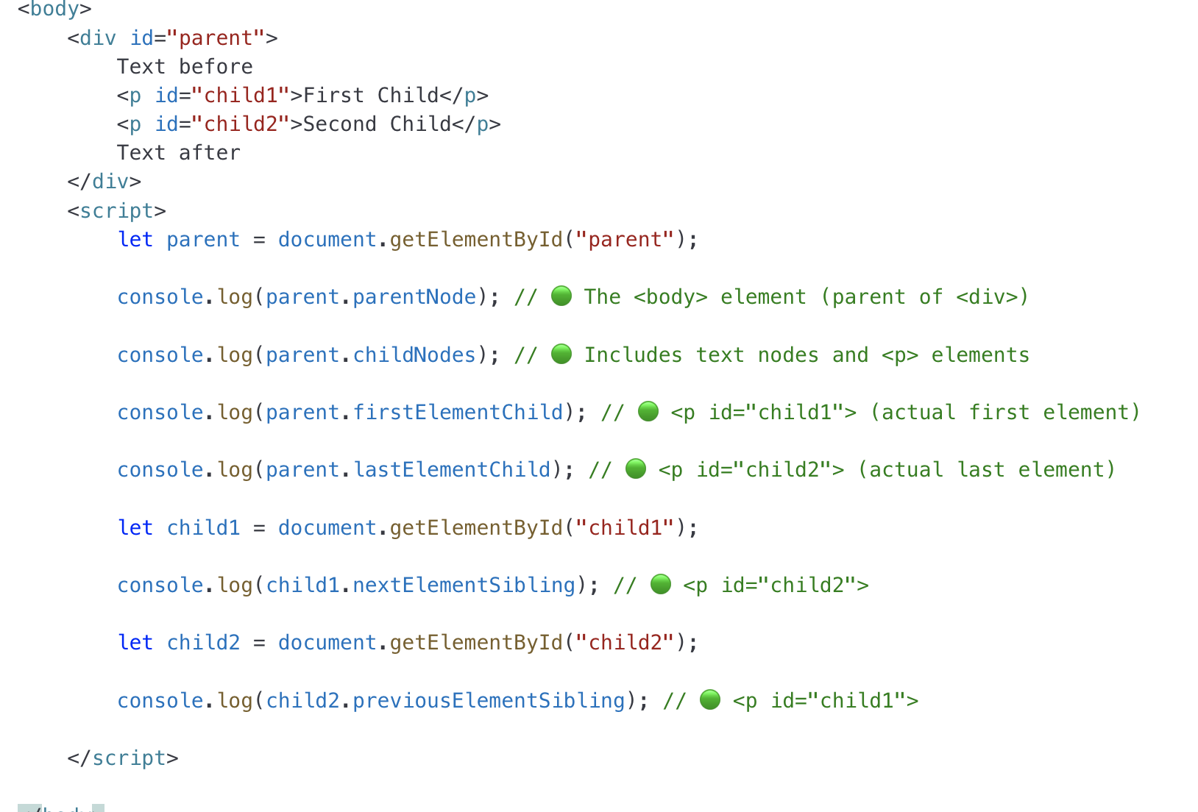
Traversing the DOM
parentNode → Access parent element
let parent = element.parentNode;
childNodes → Get child elements
let children = parentElement.childNodes;
firstChild / lastChild → Get first/last child
let firstChild = parentElement.firstElementChild;
let lastChild = parentElement.lastElementChild;
nextSibling / previousSibling → Navigate siblings
let nextSibling = element.nextElementSibling;
previousSibling = element.previousElementSibling;

Slide 13
CreateElement() + appendChild()
Used to create and add a new element at the end.
<div id="container">
<p>Existing paragraph</p>
</div>
<script>
// Step 1: Create a new element
let newParagraph = document.createElement("p");
// Step 2: Add text content
newParagraph.textContent = "I am a new paragraph added with JavaScript!";
// Step 3: Append to the parent div document.getElementById("container").appendChild(newParagraph);
</script>
What Happens?
createElement("p") → Creates a <p> element.
textContent → Adds text inside it.
appendChild(newParagraph) → Adds it inside <div id="container">.

Slide 14
createTextNode/createAttribute
We create a new text node (called newText) using the createTextNode() method. This will contain whatever text was found in textarea.
// Create a new paragraph element
let newParagraph = document.createElement("p");
// Create a text node
let text = document.createTextNode("Hello, this is a text node!");
// Create an ID attribute
let idAttr = document.createAttribute("id");
// Assign a value to the attribute
idAttr.value = "myButton";
// Append the text node to the paragraph
newParagraph.appendChild(text);
// Attach the attribute to the button
newParagraph.setAttributeNode(idAttr);
// Append the paragraph to the body
document.body.appendChild(para);

Slide 15
Adds an Element Before Another
The insertBefore() method inserts an element before a specific existing child.
parentElement.insertBefore(newElement, existingChild);
Example: Inserting a New Item Before Another
// Select the parent
let parent = document.getElementById("container");
// Create a new element
let newItem = document.createElement("p");
newItem.textContent = "This is inserted before an existing item!";
// Select an existing child
let existingItem = document.getElementById("oldItem");
// Insert before oldItem
parent.insertBefore(newItem, existingItem);
The new <p> is added before #oldItem.

Slide 16
Remove Child
let parent = document.getElementById("container");
let child = document.getElementById("item");
parent.removeChild(child);
Finds the parent element with ID "container"
Removes the child element with ID "item"

Slide 17
Delete last paragraph on the page
var allGrafs = document.getElementsByTagName("p");
getElementsByTagName method collect all the paragraph tags in our page and store them in the allGrafs array.
if (allGrafs.length > 1){
var lastGraf = allGrafs[allGrafs.length-1];
var docBody = document.getElementsByTagName("body")[0];
docBody.removeChild(lastGraf);
}
In order to modify the document we need to get the content of the body.
Once we have got that, its simply a matter of calling the
docBody.removeChild() method and passing it lastGraf.
Which tells JavaScript which paragraph we want to delete. Our page
should immediately show one less paragraph

Slide 18
Removing an Element When Clicking a Button
<div id="container">
<p id="text">Click the button to remove me!</p>
<button onclick="removeElement()">Remove</button>
</div>
<script>
function removeElement() {
let element = document.getElementById("text");
if (element) {
element.remove(); // Removes the paragraph
}
}
</script>

Slide 19
Replacing Node
<div id="parent">
<p id="oldChild">This is the old paragraph.</p>
</div>
<button onclick="replaceElement()">Replace Child</button>
<script>
function replaceElement() {
let parent = document.getElementById("parent");
let oldChild = document.getElementById("oldChild");
// Create a new element
let newChild = document.createElement("p");
newChild.textContent = "This is the new paragraph.";
// Replace the old child with the new one
parent.replaceChild(newChild, oldChild);
}
</script>

